Slide 1
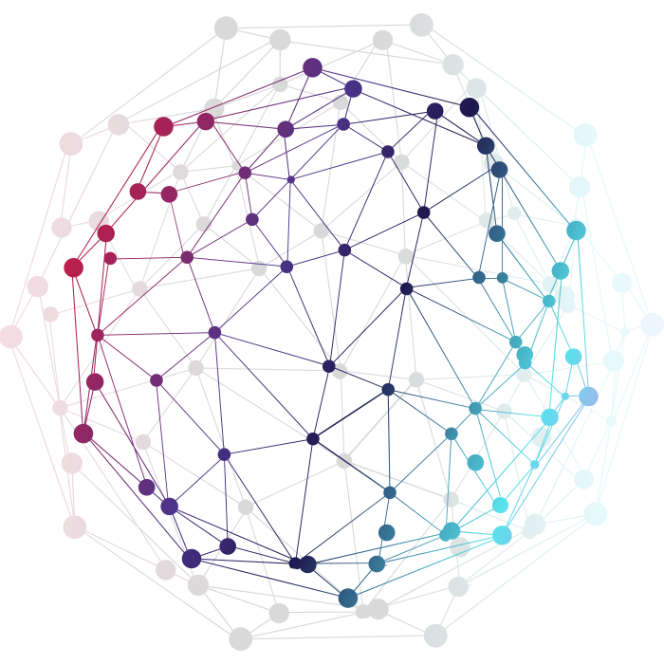
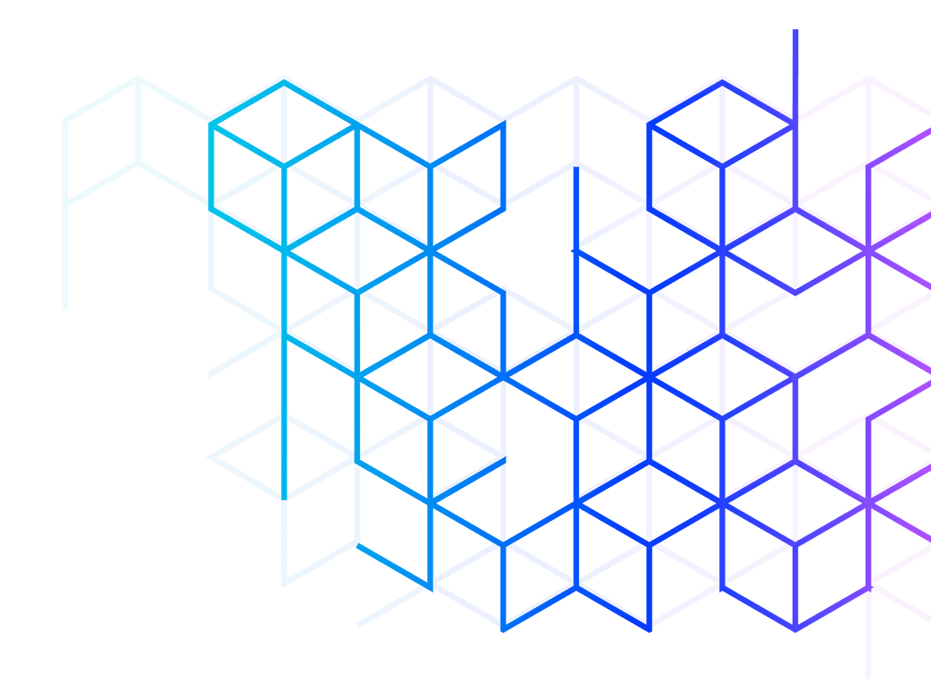
Design and Implementation of a Prototype for an Optimistic Rollup System
Master’s Thesis
Dakila Madushanka Serasinghe
Examiners: Prof. Dr. Peter Thiemann
Prof. Dr. Andreas Podelski
Advisor: Dr. Thi Thu Ha Doan

Slide 2
Expected Deliverables
Objective:
Investigate the design and implementation of a rollup system for the Ethereum Blockchain
Only transfers of Ether
Optimistic Rollup
A Single Aggregator/Sequencer
Writing Period: 22.12.2022 – 22.06.2023

Slide 3



Introduction
Blockchain as a technology has revolutionized
various industries.
Mass adoption is hindered by the issue of “Scalability”.
Real-Time Transactions
High Transaction Costs
Notes:
Financial market, supply chain, health case and law management
In finance blockchain has enabled faster and more secure cross-border transactions, streamlined payment processes
In supplychain – traceability, authenticity verification improved efficiency.
Data security

Slide 4
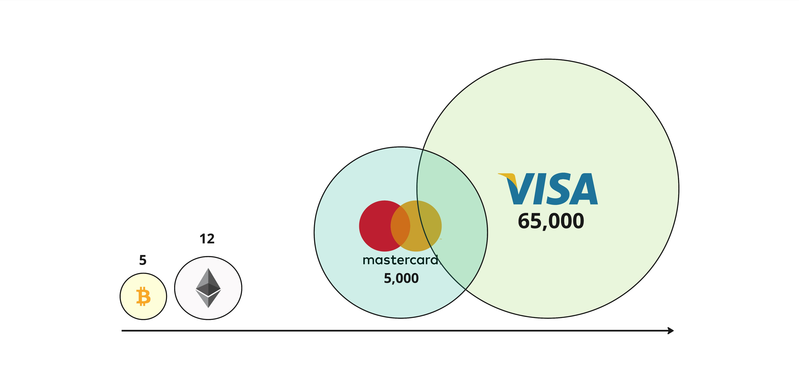
Blockchain vs Centralized Systems
Throughput

Slide 5
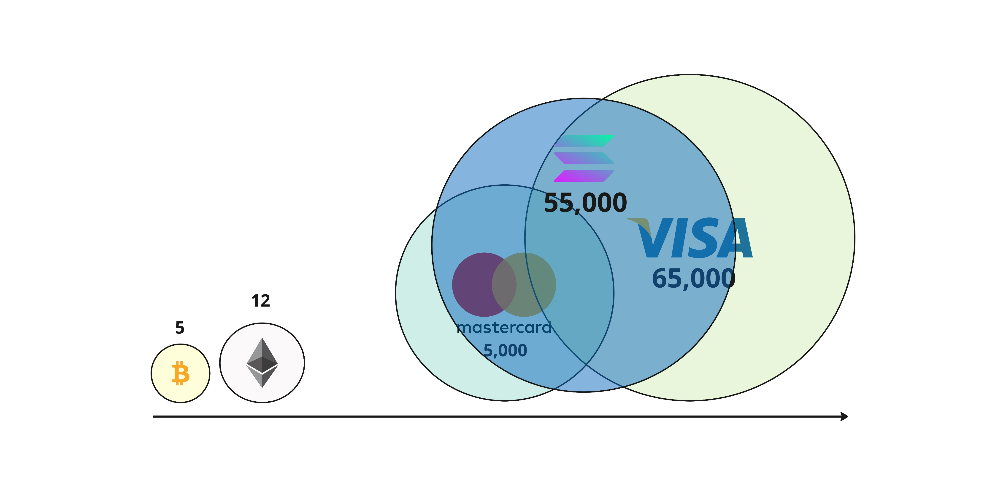
Blockchain vs Centralized Systems
Throughput

Slide 6
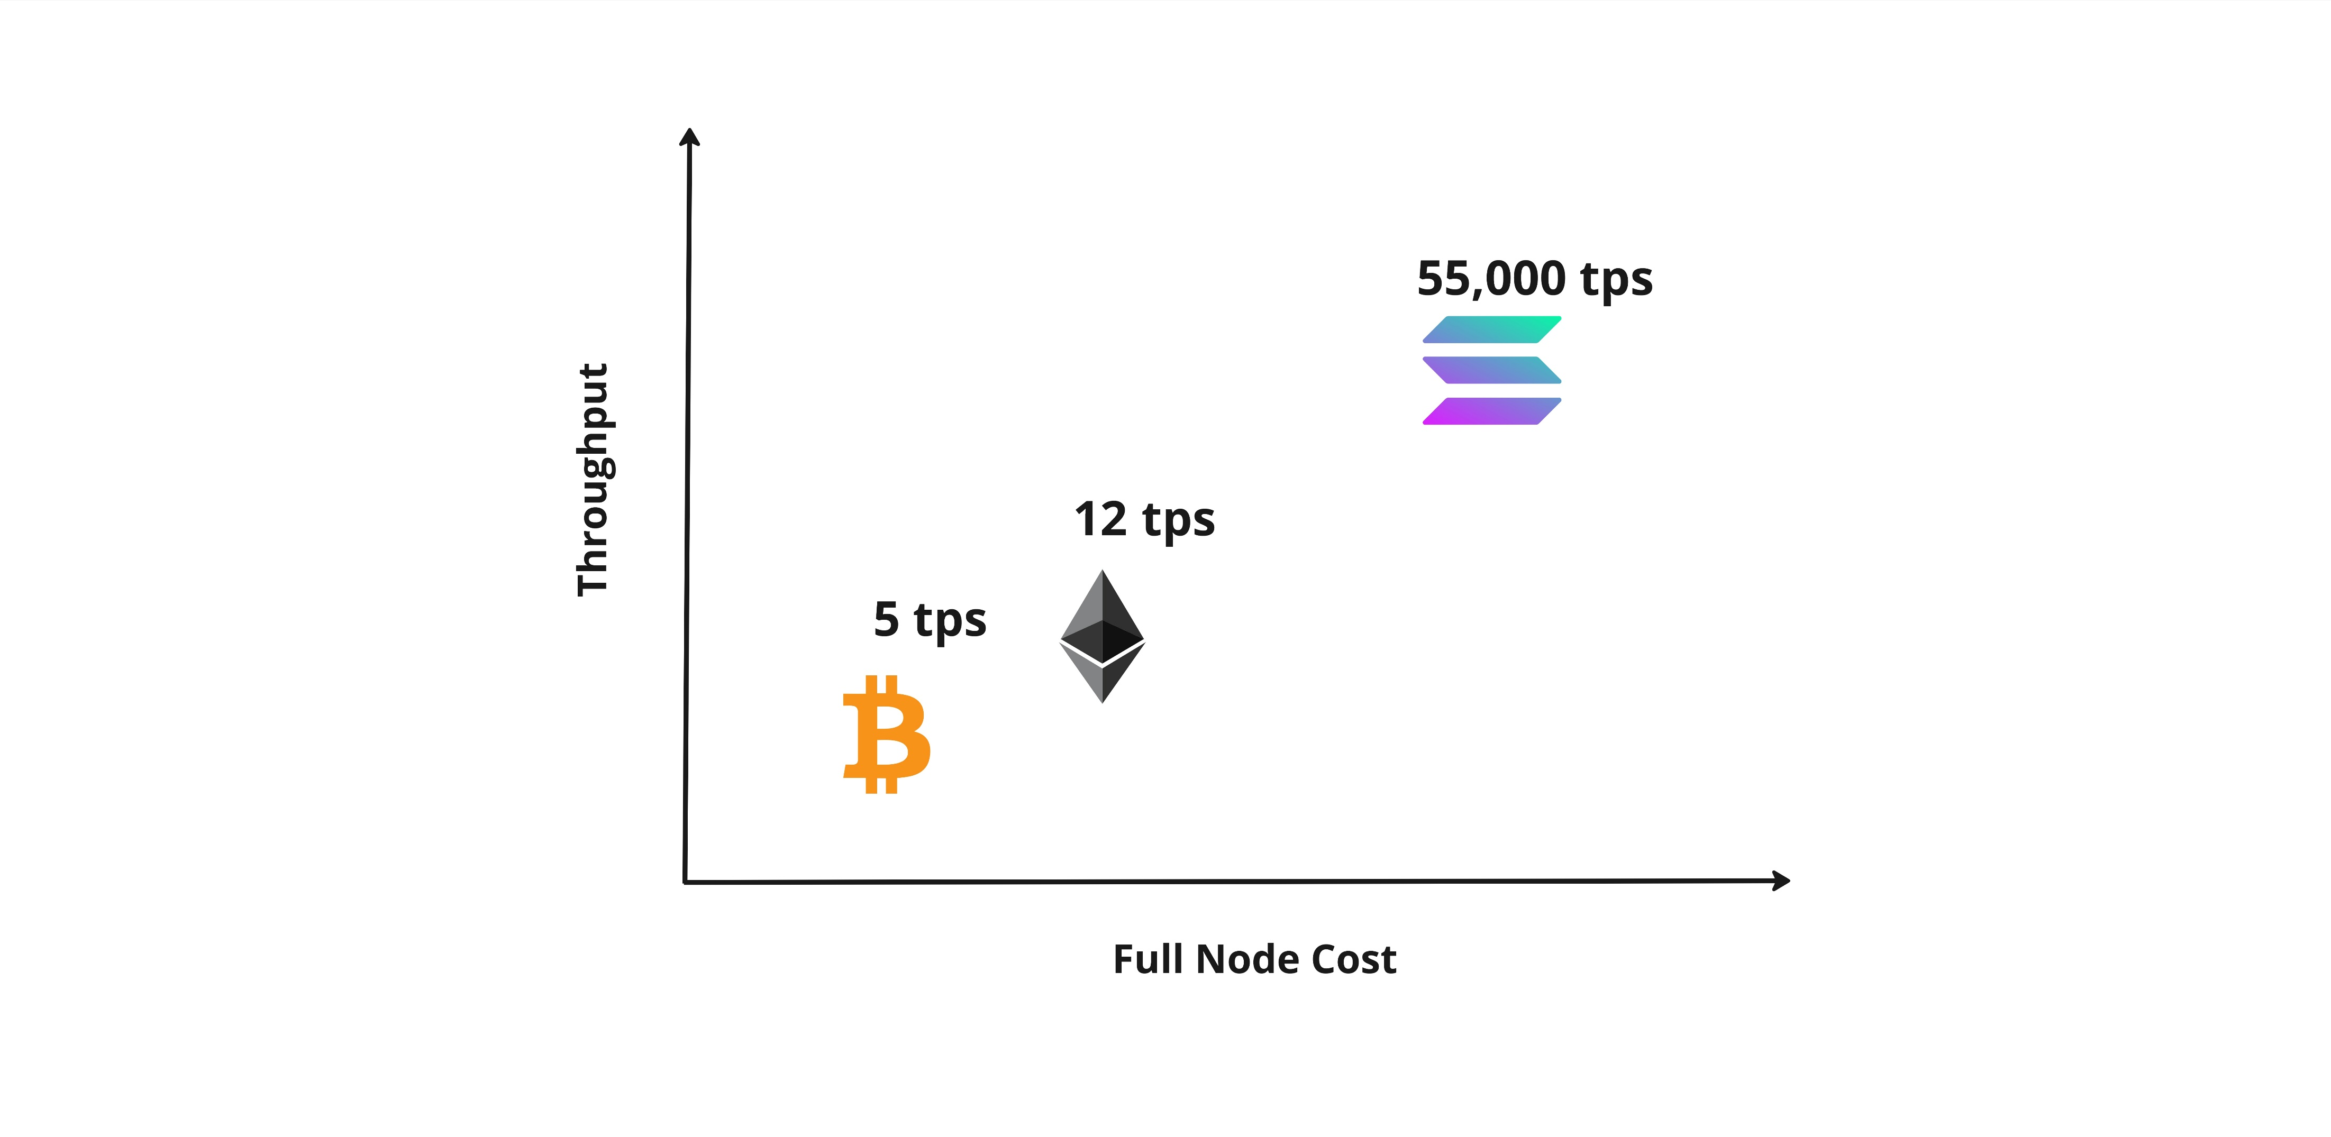
Throughput vs. Node Cost

Slide 7

Throughput vs. Node Cost
Decentralized
Nakamoto Coefficient
Bitcoin | 8700
Ethereum | 5500
Solona | 32

Slide 8
Throughput vs. Node Cost
Decentralized
Nakamoto Coefficient
Bitcoin | 8700
Ethereum | 5500
Solona | 32
Scalability

Slide 9
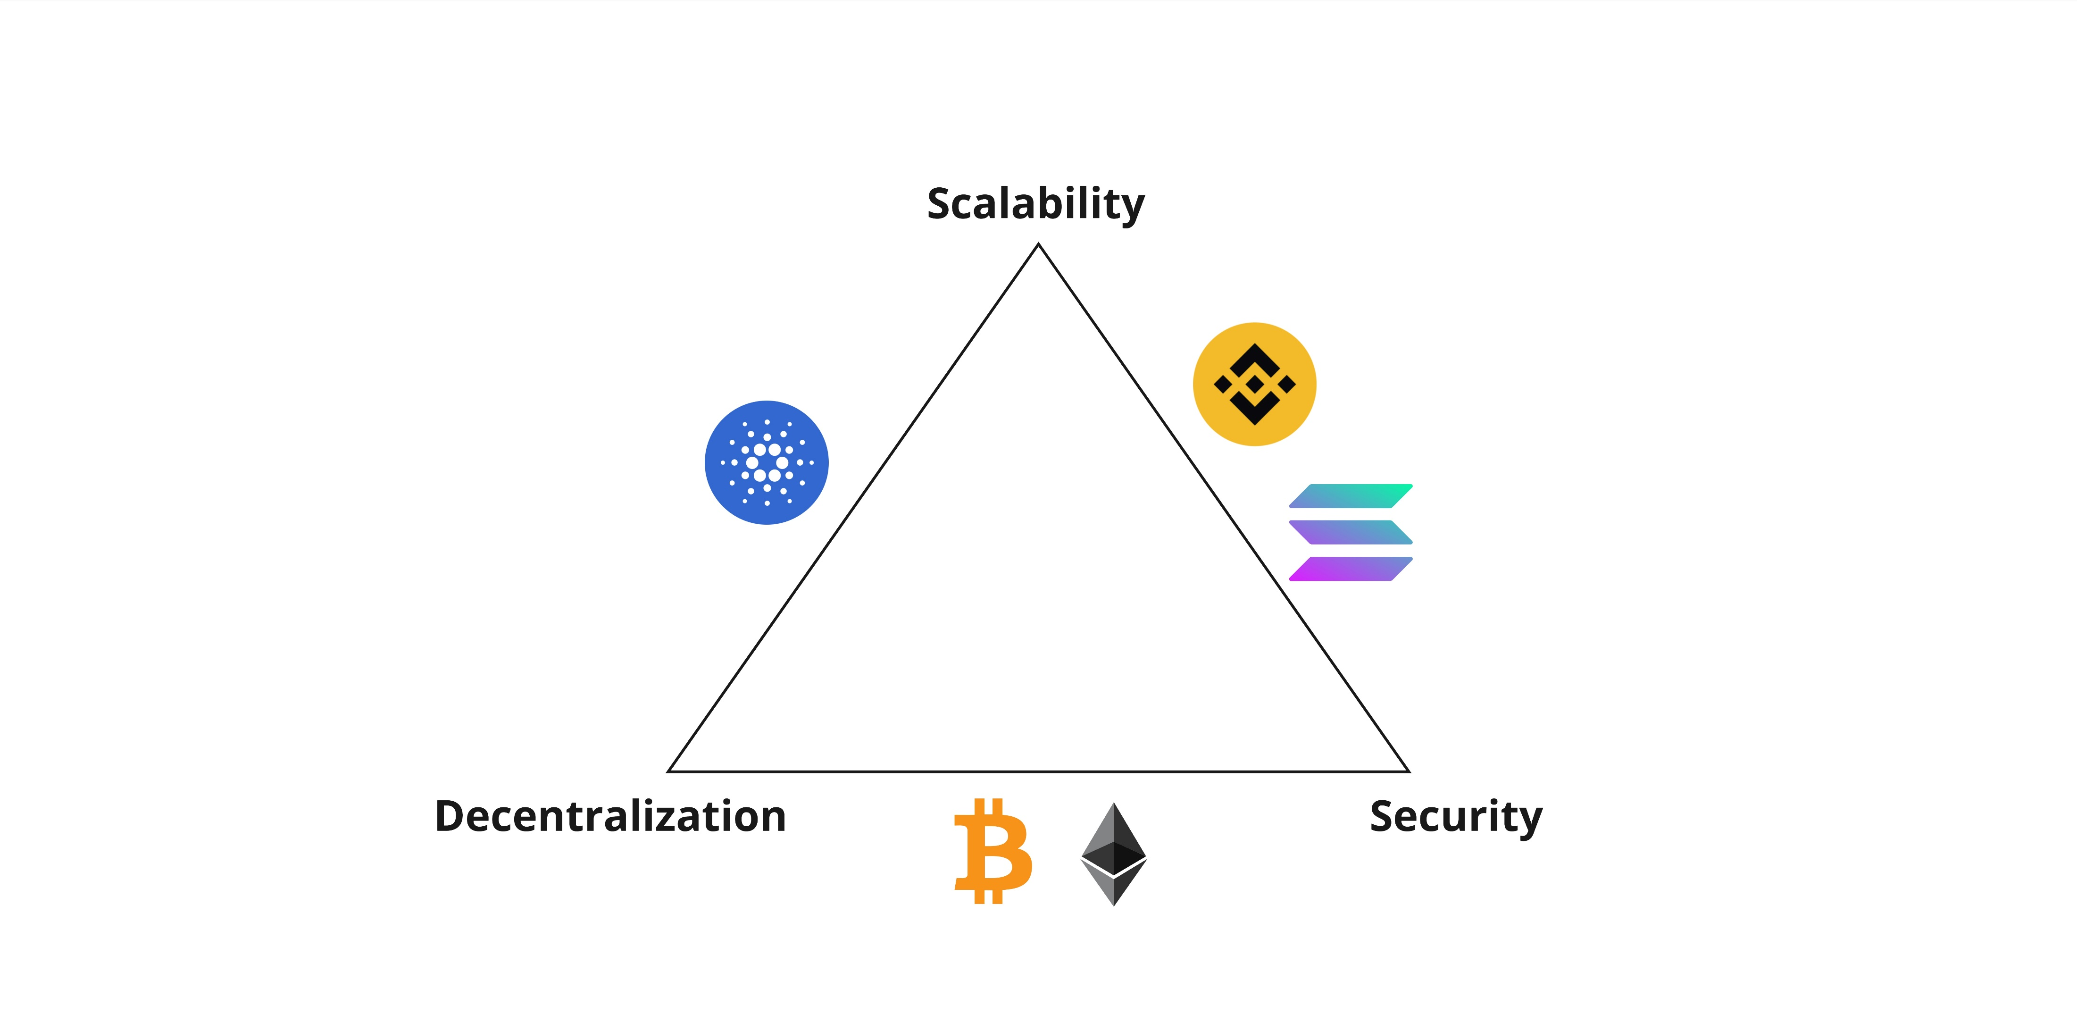
Scalability Trilemma

Slide 10
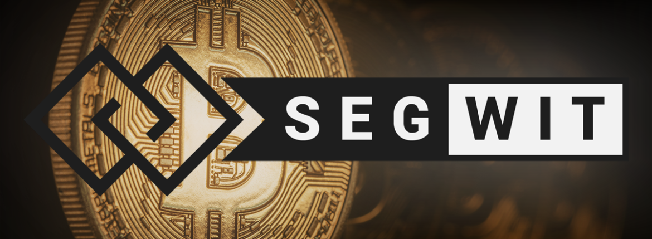
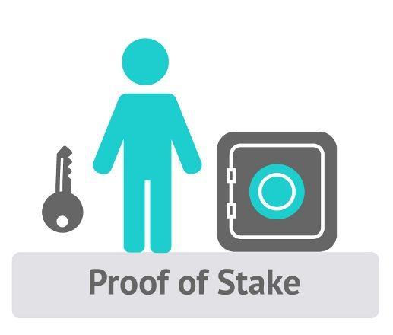

Layer-1 Solutions for Scalability
Modification of Block Sizes and Data
Segregated Witness (SegWit)
Efficient block compression
Alternative Consensus Mechanisms
Proof-of-Stake (PoS)
Delegated-Proof-of-Stake (DPoS)
Blockchain Sharding
Beacon-chain in Ethereum, Polkadot
Alternative Data Structures
Directed Acyclic Graphs (DAG)
Notes:
Beacon chain in Ethereum and Polkadot
DAG in Avalanche – tree like data structure allowing multiple processes to run simultaneously.

Slide 11
Drawbacks of Layer-1 Solutions
Introduce trust into the Network
Necessity of Hard-forks
Higher propagation delays
Increased operational costs

Slide 12
What is the Layer-2 in Blockchain?
Any off-chain network or system that is built on top of a traditional blockchains (Layer-1)
Layer-2 introduce alternative approaches for scalability challenges
Layer-2
Layer-1
Layer-0

Slide 13
Layer-2 Solutions
State Channels
Side Chains
Plasma
Rollups

Slide 14
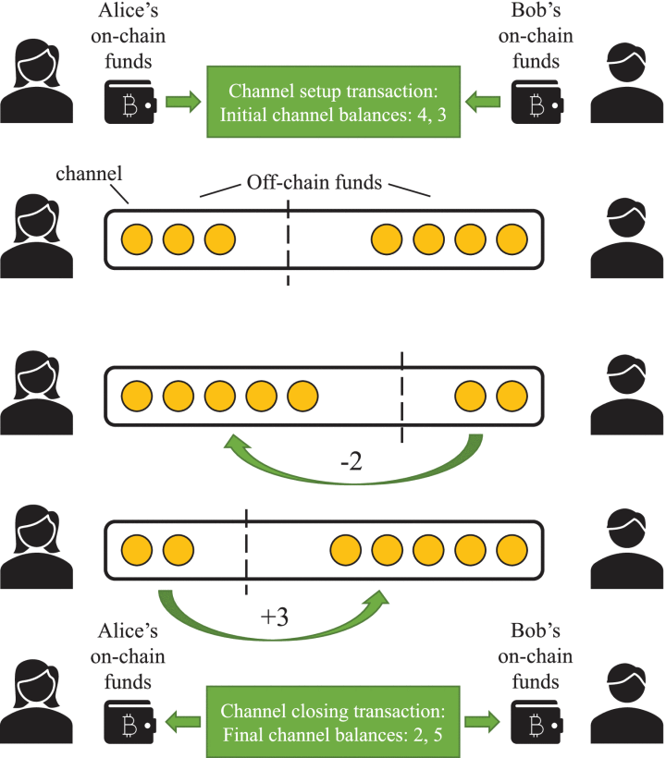
Layer-2 Solutions : State Channels
Peer-to-peer protocol with two or
more interacting off-chain
Extremely low transaction costs
Increased Privacy
Instant Finality
The lifecycle of a payment channel (N. Papadis and L. Tassiulas, "Blockchain-Based Payment Channel Networks: Challenges and Recent Advances," in IEEE Access, vol. 8, pp. 227596-227609, 2020.)

Slide 15
Drawbacks of State Channels
Predefined Participants
New channel for each new participant
Additional set-up costs
Liveness assumption of participants
Users should be aware of malicious state
Submissions
Data Unavailability
Users are expected to maintain the latest state

Slide 16
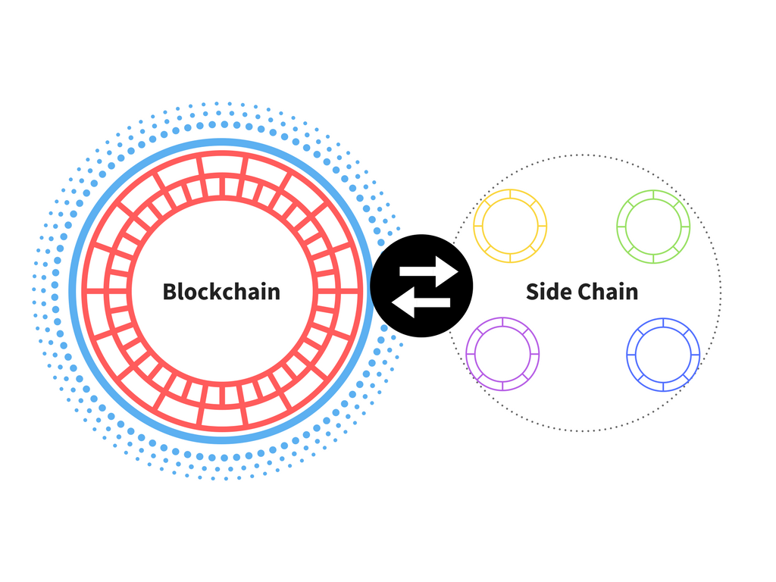
Layer-2 Solutions : Sidechains
Sidechain is a separate blockchain running parallel to the mainnet
They are connected to the parent-chain via a two-way peg bridge
Use of Different consensus mechanism
Source: https://blockchainfiles.org/what-are-sidechains/

Slide 17
Drawbacks of Sidechains
Poor Security
Different Consensus protocol with a limited number of validators
Data Unavailability
No state commitments to the mainnet
No transaction data in mainnet

Slide 18
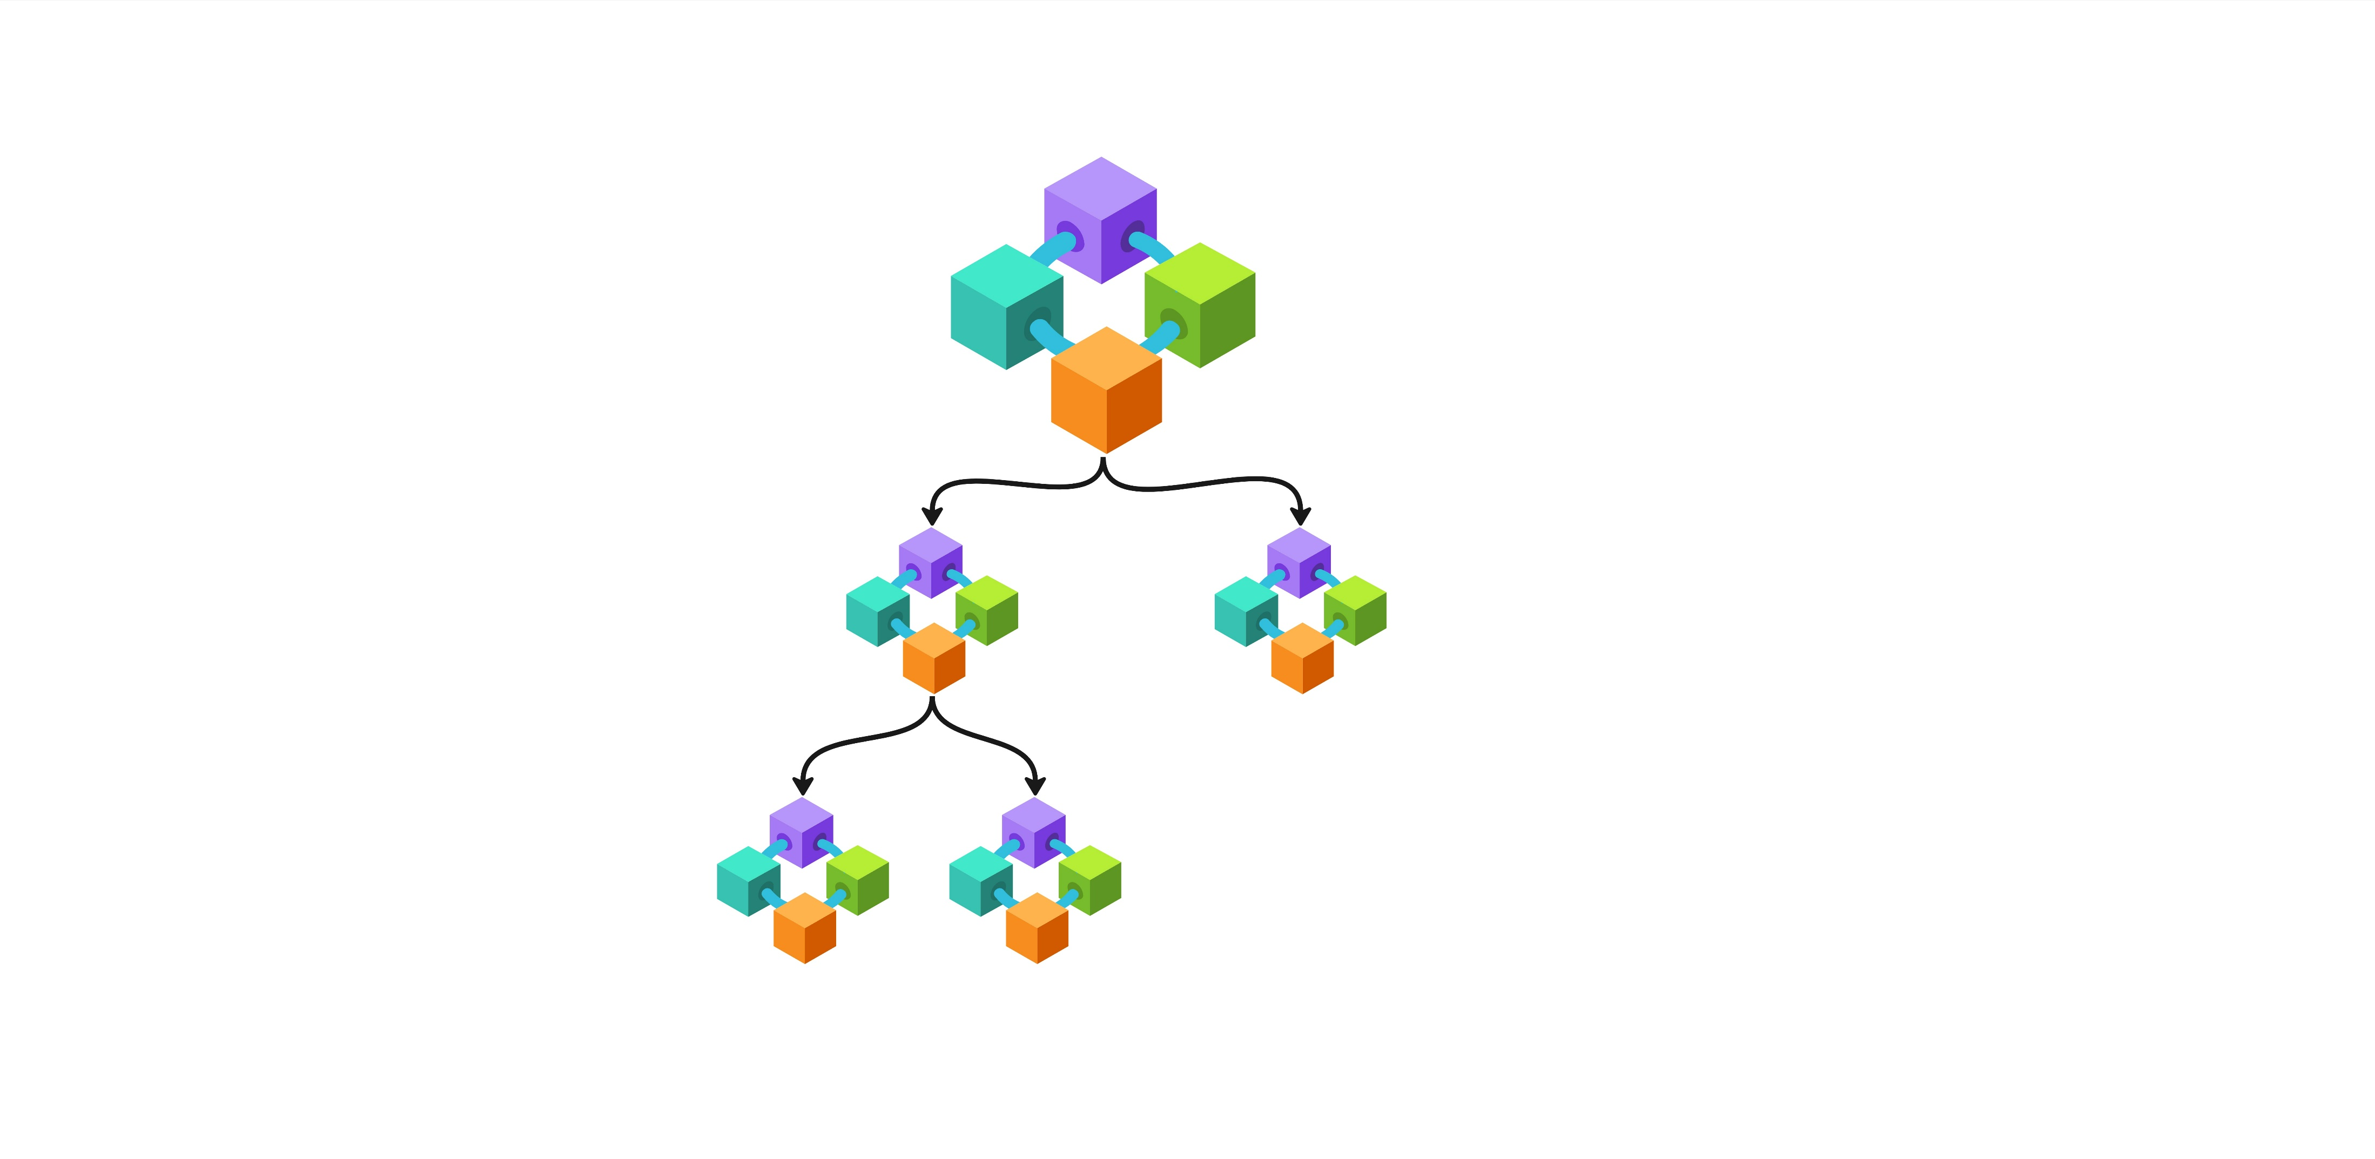
Layer-2 Solutions : Plasma
Plasma is a framework of “Blockchain of Blockchains”
‘child-chains’ are scaled down versions
of Ethereum
Improves security issues in Sidechains
Enable unlimited user-participation
Ethereum
Child-chain
Child-chain

Slide 19
Drawbacks of Plasma
Data Unavailability
No transaction data in mainnet
Does not support general computation
Can not run smart contracts
Delayed Withdrawals
Withdrawals delayed by challenge period

Slide 20
Rollups
Rollups improve from all previous Layer-2 solutions
Rollups move transaction execution Off-chain as Sidechains and Plasma
Aggregate transactions “Roll Up” and post in Layer-1
Rollups is the most secure Layer-2 solution
Submits both state commitments and transaction data
Optimistic and Zero-Knowledge

Slide 21
Comparison of Layer-2 Solutions
Aspect | Channels | Sidechains | Plasma | Optimistic Rollup | Zero-Knowledge Rollup
Transaction Speed | Fast | Moderate | Moderate | Slow | Slowest
Transaction Cost | Very Low | Low | Very Low | Low | Low
On-chain Account | Yes | No | No | No | No
Capital Efficient | No | Yes | Yes | Yes | Yes
Finality | Instant | N/A | One Confirmation | One Confirmation | < 10 mintues
Liveness Assumption | Yes | Bonded | Yes | Bonded | No
Fund Freezing | No | Yes | No | No | No
Vulnerability to Crypto-economic Attacks | Moderate | High | Moderate | Moderate | Moderate

Slide 22
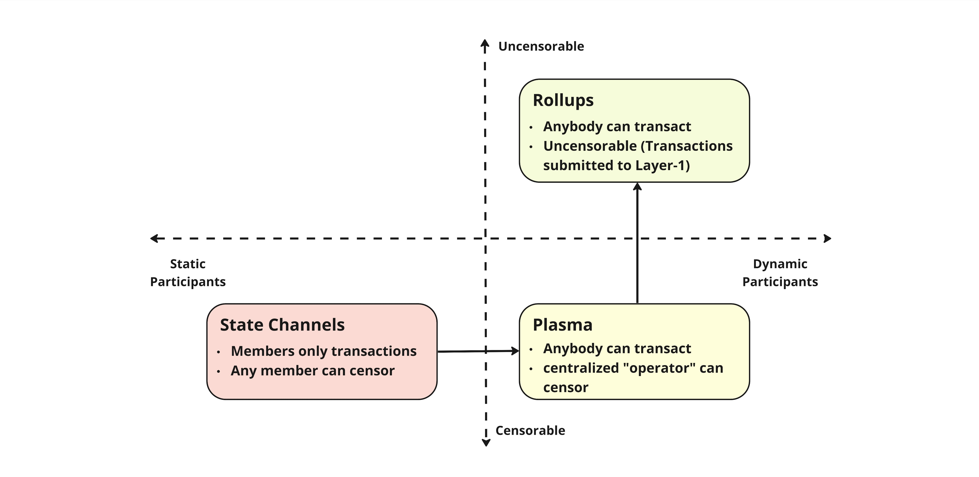
Rationale for Rollup as a feasible Layer-2 Scaling Solution

Slide 23
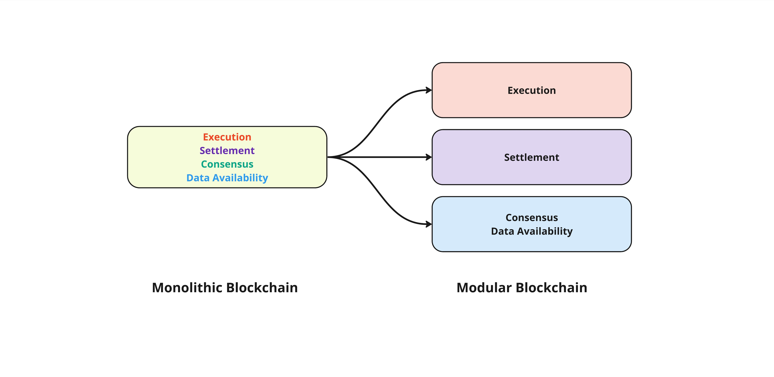
Modular Blockchain Architecture

Slide 24
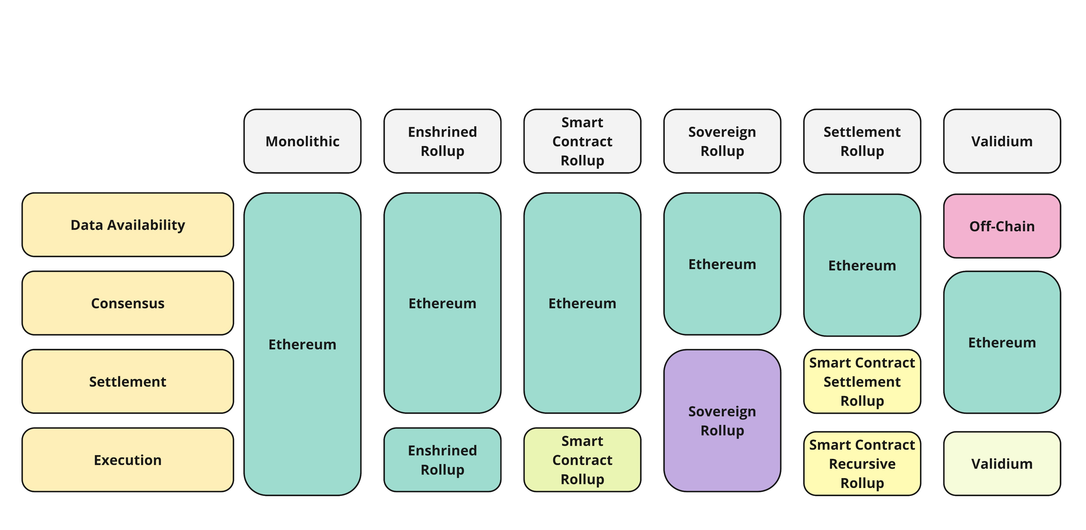
Flavors of Rollups

Slide 25
Optimistic Rollups
Optimistic Rollups are same as Plasma, but improves data availability
By posting compressed transactions
“Optimistic” as assumes Valid until Proven
System Actors :
Sequencer/Aggregator - Create batches of transactions and periodically submit state commitments.
Verifier - Monitor network and ensure chain integrity

Slide 26
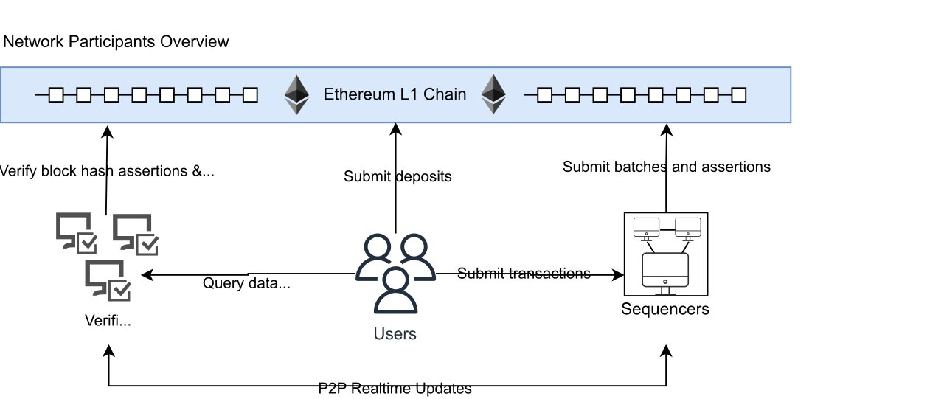
Optimistic Rollup Architecture
Verify block hash assertions &
submit fault proofs
Submit batches and assertions
Submit deposits
Query data
Submit transactions
Verifiers
Verifiers
P2P Realtime Updates
Optimism (Bedrock upgrade) – Network participants Overview

Slide 27
Dispute Resolution Mechanism
Single-Round Dispute Resolution
Complete Batch is validated
Faster
High cost
Multi-Round Dispute Resolution
A Granular validation of batches and transactions
Interactive multi-round process between sequencer and verifier
Slower but low-cost

Slide 28
Zero-Knowledge Rollups
Verified using Zero-Knowledge proofs as posted into the Layer-1
Faster Finality
System Actors :
Sequencer/Aggregator - Create batches of transactions and periodically submit state commitments.
Verifier - Monitor network and ensure chain integrity
Prover – Generate cryptographic Proofs for the transaction batches

Slide 29
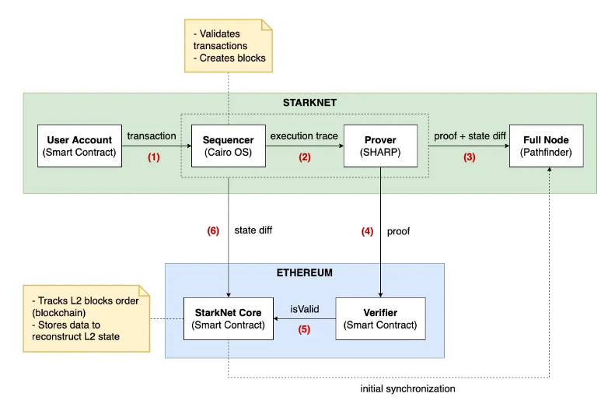
Zero-Knowledge Rollup Architecture
The System Architecture of StarkNet

Slide 30
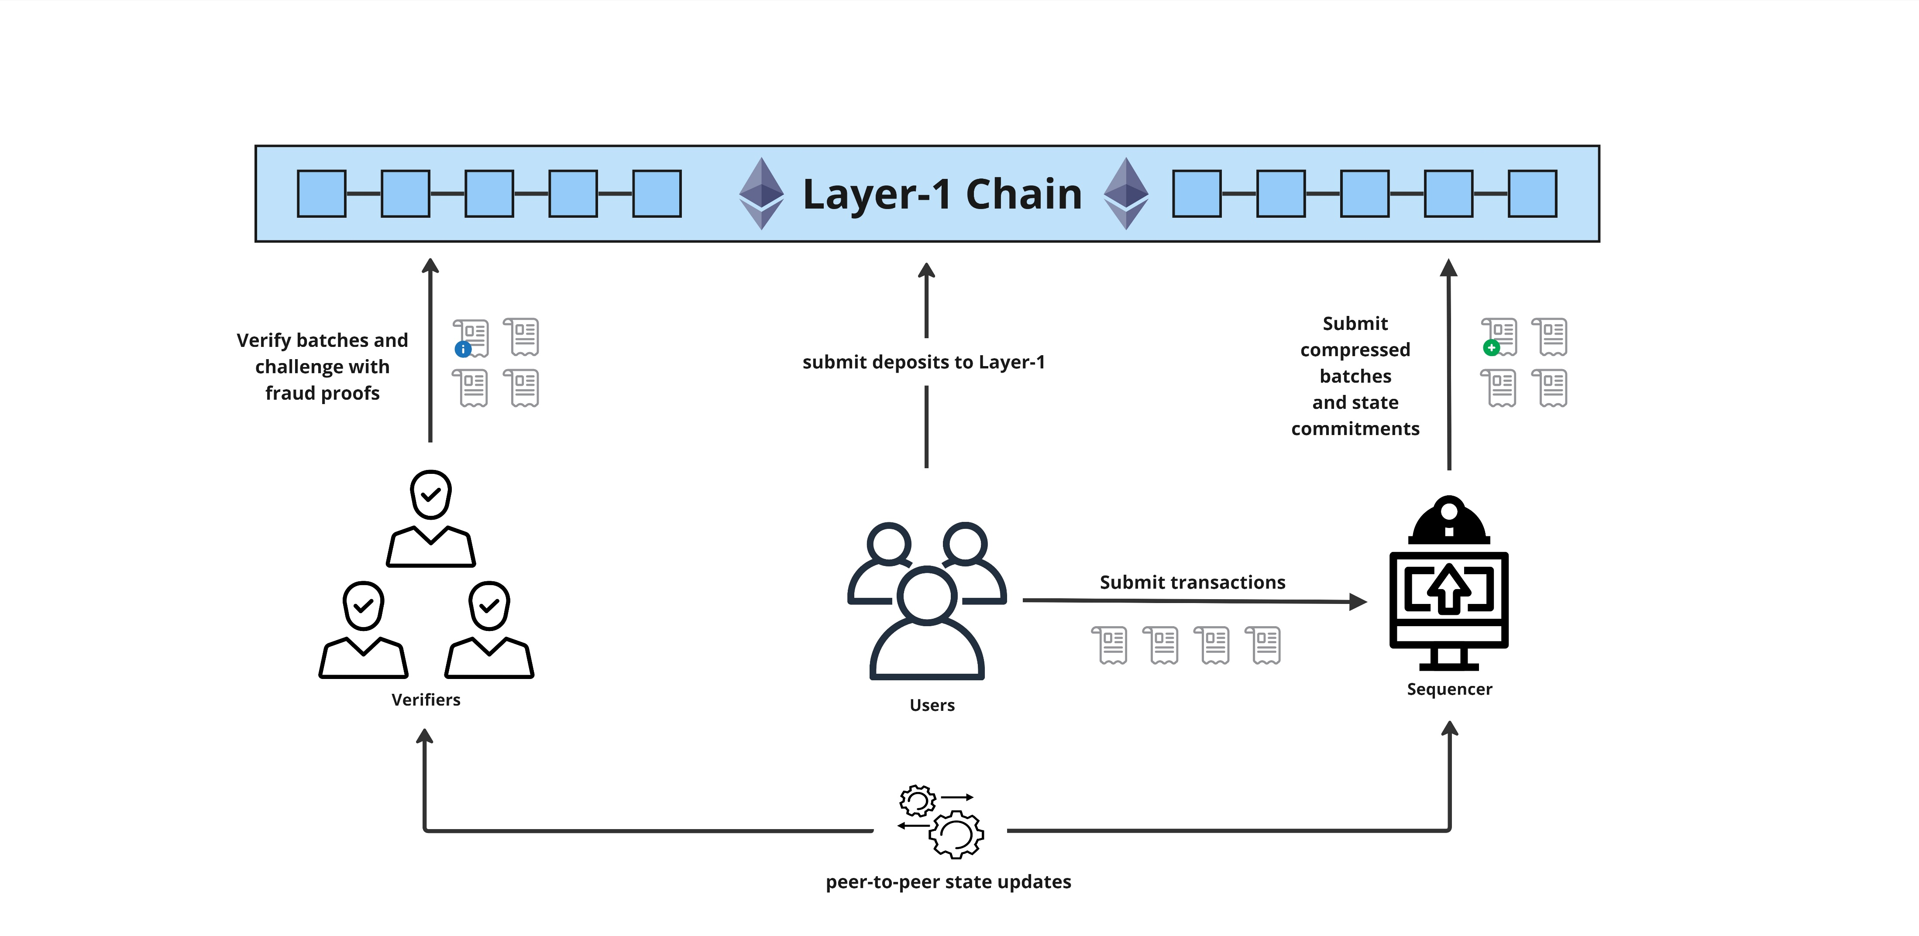
Our Optimistic Rollup Architecture

Slide 31
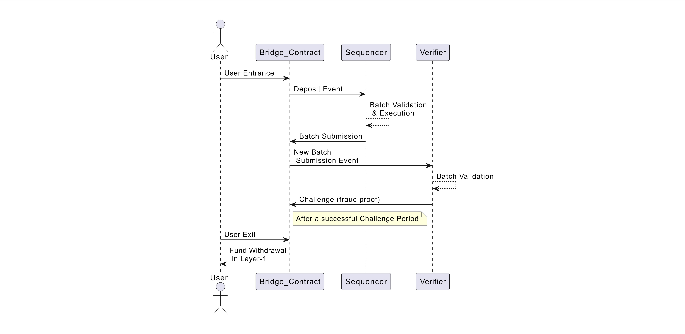
Simplified Sequence Diagram

Slide 32
Types of Transactions
Deposit Transaction – l1deposit
Entry to the Rollup system
Layer-2 User Transaction – l2transfer
Peer-to-peer Layer-2 transfers
Withdrawal Transactions – l2withdraw, l1withdraw
User exit from the Rollup

Slide 33
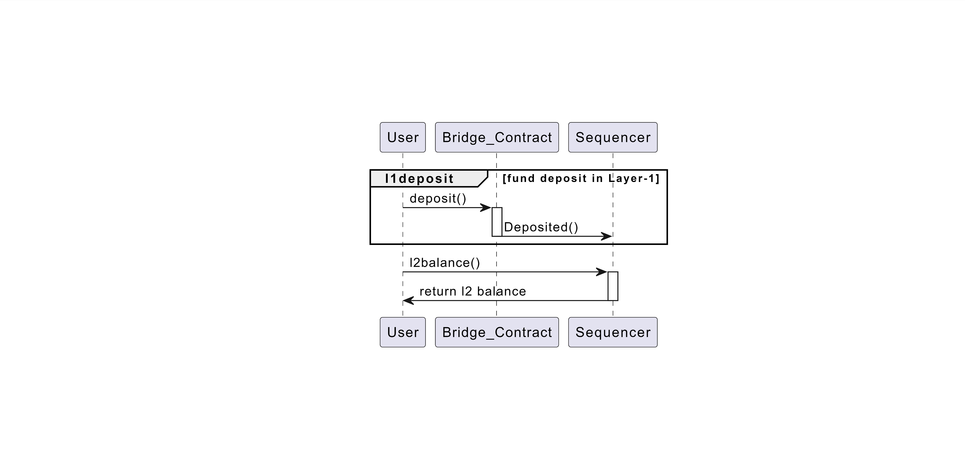
User Entrance to Rollup

Slide 34
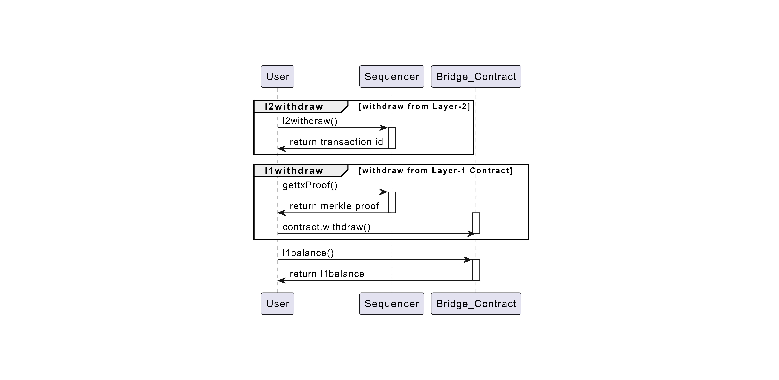
User Exit from the Rollup

Slide 35
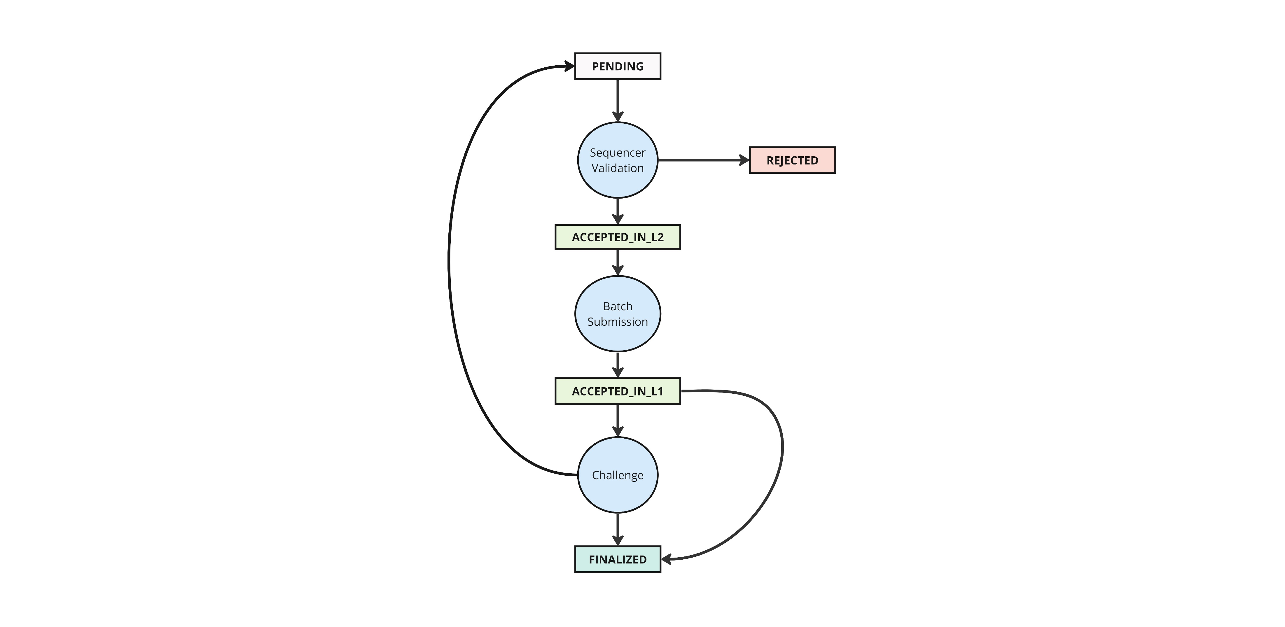
Transaction Lifecycle
User transaction
Invalid transaction
Valid transaction
Verifier wins the challenge and
chain is rearranged
Batch submission to Layer-1 successful
Batch is not challenged and
after a successful challenge
period
Sequencer wins the challenge

Slide 36
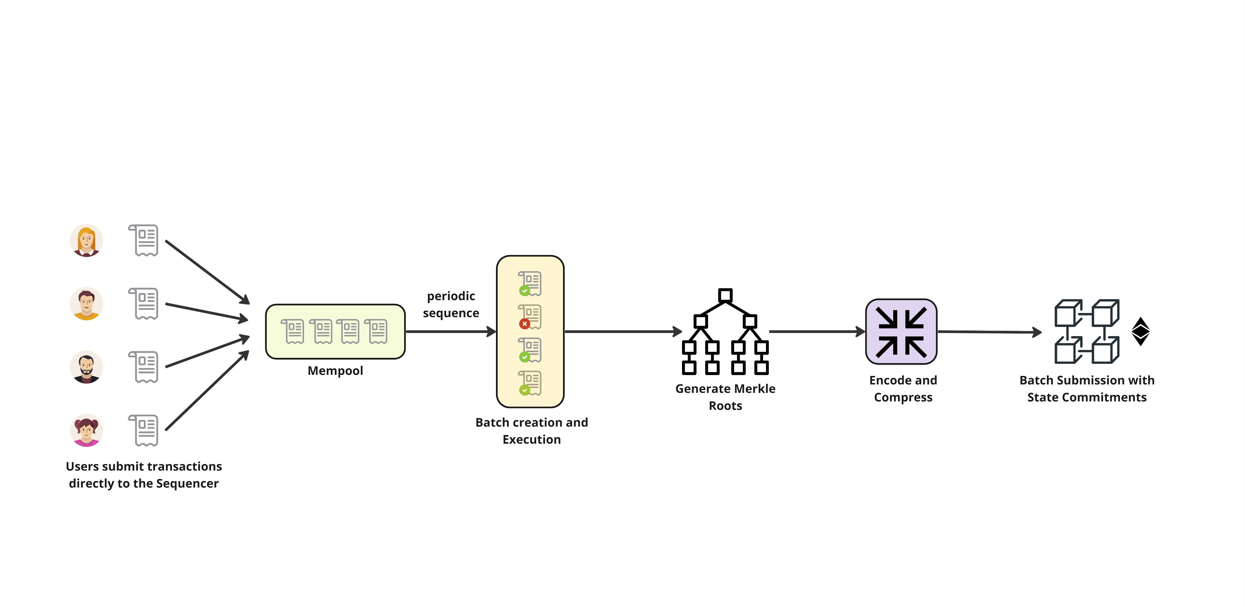
The Sequencer

Slide 37
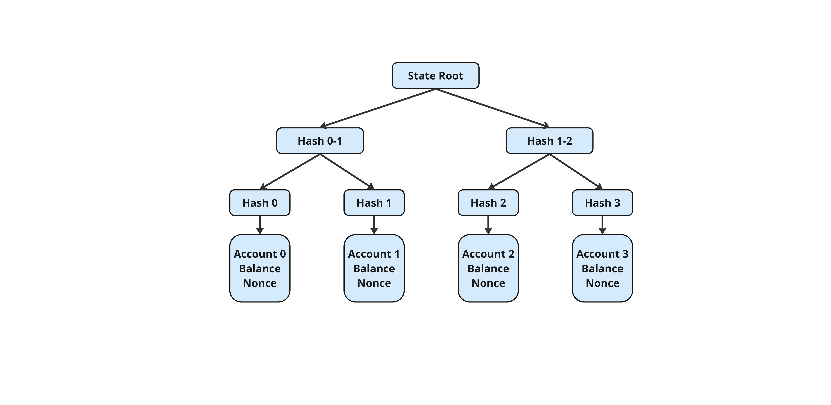
State Root Generation

Slide 38
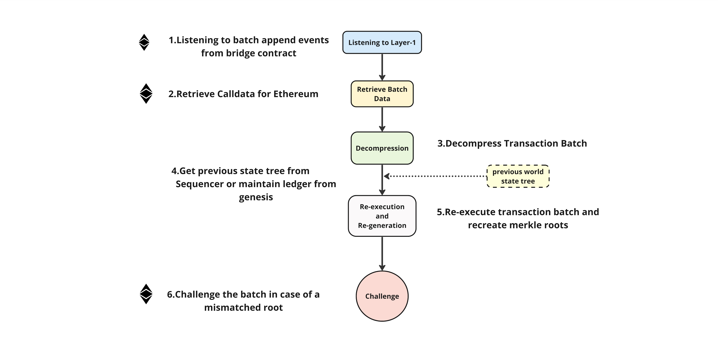
The Verifier – Verification Process

Slide 39
The Bridge Contract
Protocol assumptions on the Layer-1 Blockchain
Neutrality : Validators of the underlying blockchain are not colluding with Rollup operators (Sequencer)
Eventual Delivery : Given an appropriate base fee, a user transaction is always
Included in a block
Safety of Smart Contract : Bridge is not compromised

Slide 40
Responsibilities of the Bridge Contract
Facilitate user entrance and exit
Maintain Rollup state (State-Commitment-Chain)
Dispute resolution

Slide 41
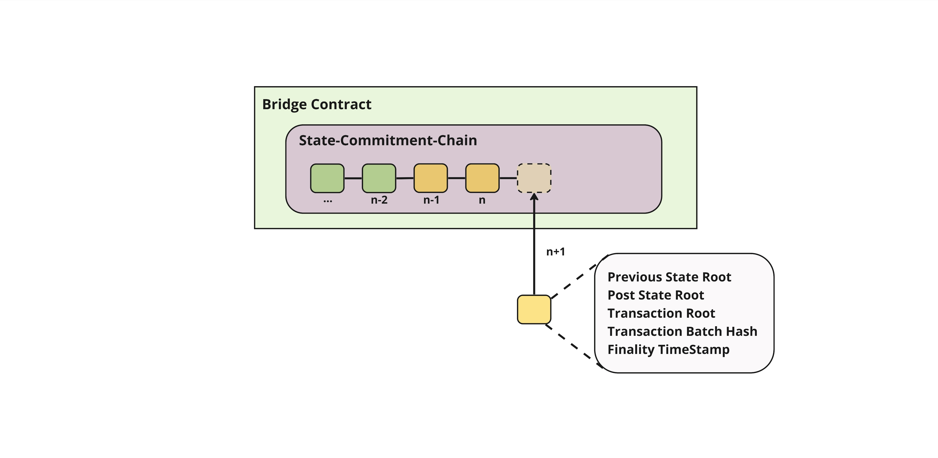
State-Commitment-Chain
Transaction batch hash is
Calculated by hashing the transaction batch
Sequencer append batch to the
SCC

Slide 42
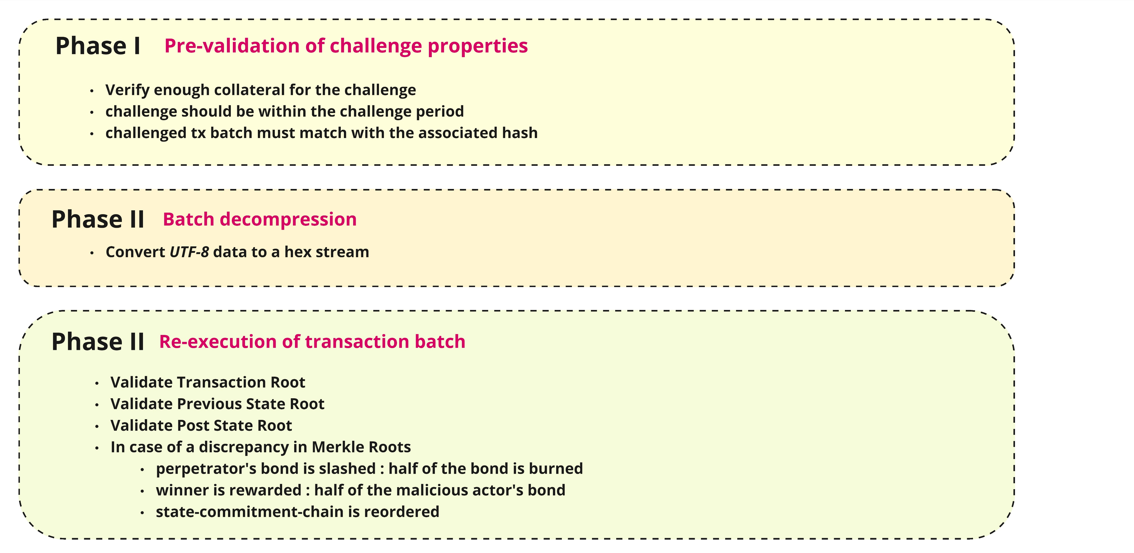
Dispute Resolution Protocol

Slide 43
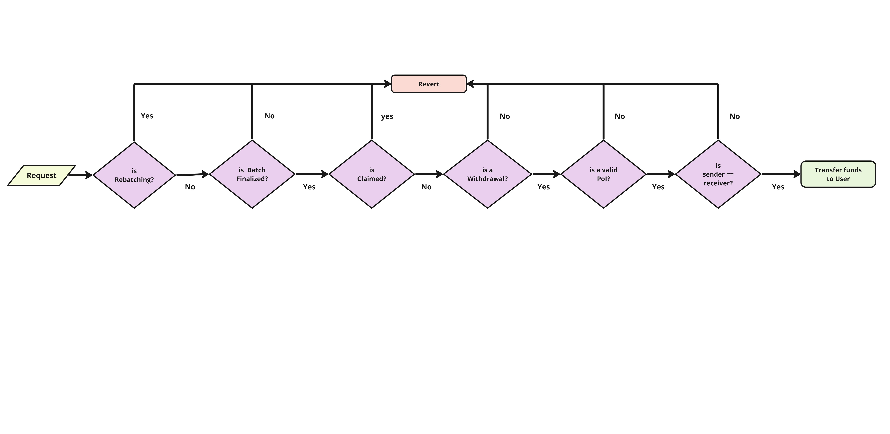
Authentication Process for Layer-1 Withdrawals

Slide 44
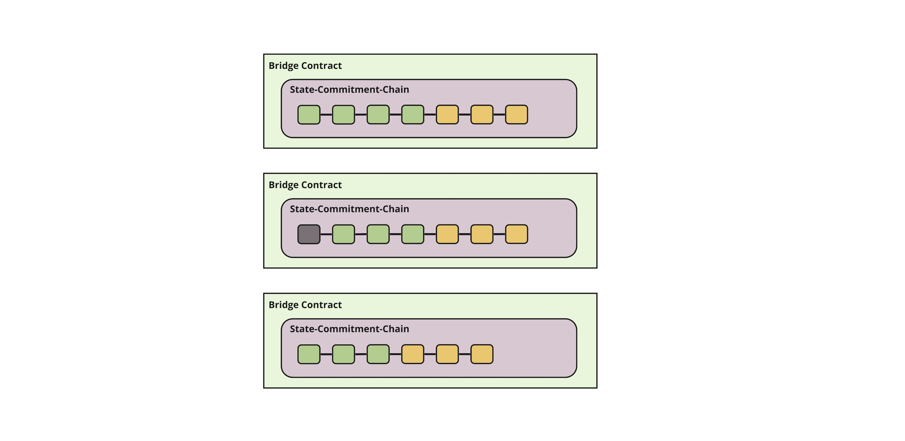
State-Commitment-Chain Maintenance
SCC get appended continuously by Sequencer
Block get matured after the maturity period (set as 3*challenge period)
Block is released

Slide 45
User Wallet
Add <key> <privateKey>
Show
l1deposit <key> <ether>
l1balance <key>
l2balance <key>
l2transfer <key> <target> <value> <nonce>
l2withdraw <key> <value> <nonce>
l1withdraw <key> <id>

Slide 46
Calldata Compression
Algorithm | Batches of Transactions |  | Single Transactions
 | Compression Rate(%) | Estimated Fee Savings (%) | Compression Rate(%) | Estimated Fee Savings (%)
Zlib | 40.13 | 42.67 | 63.97 | 8.61
Zstd | 40.12 | 42.68 | 62.87 | 10.18
LZW | 62.24 | 11.09 | 68.29 | 2.44
Brotli | 39.21 | 43.99 | 65.78 | 6.02
ZLE | 59.37 | 15.18 | 59.37 | 15.18
Calldata Compression Analysis in Optimism
Compression rate = compressed data size as a percentage of uncompressed data size
Fee Saving = assuming 40% of bytes in a transaction are of zero-bytes

Slide 47
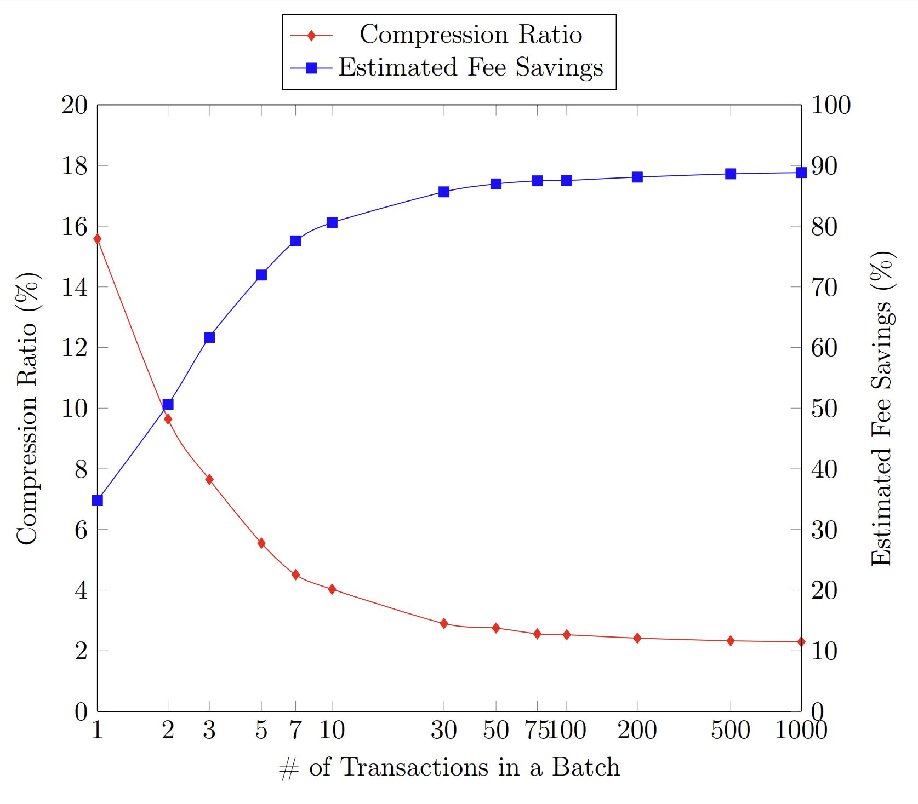
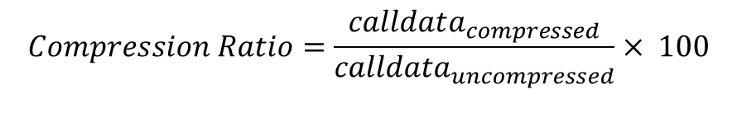
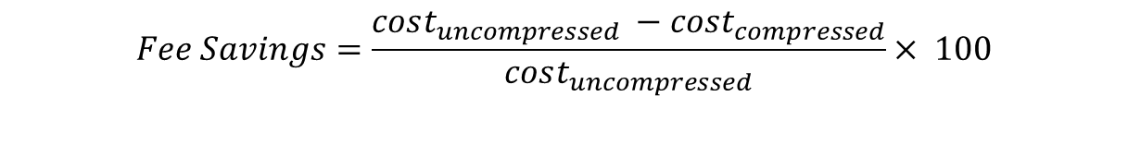
Calldata Compression – This Work
Pako compression : a zlib-compatible compression implementation
Puff decompression : a zlib decompression variant
$$Fee Savings=\frac{cost_{uncompressed} −cost_{compressed}}{cost_{uncompressed}}× 100$$
$$Compression Ratio=\frac{calldata_{compressed}}{calldata_{uncompressed}}× 100$$

Slide 48
Security Assumptions
Assumption 1: Liveness of Sequencer and Validators
No Escape Hatch
Assumption 2: Liveness of 1-of-N Honest Verifiers
Verifier’s Dilemma
Assumption 3: Censorship Resistance
Layer-1 Censorship resistance
Forking Censorship and Block-Building Censorship
Layer-2 Censorship resistance
User censoring
Assumption 4: Fair Sequencing and Execution
MEV (Maximum Extractable Value)

Slide 49
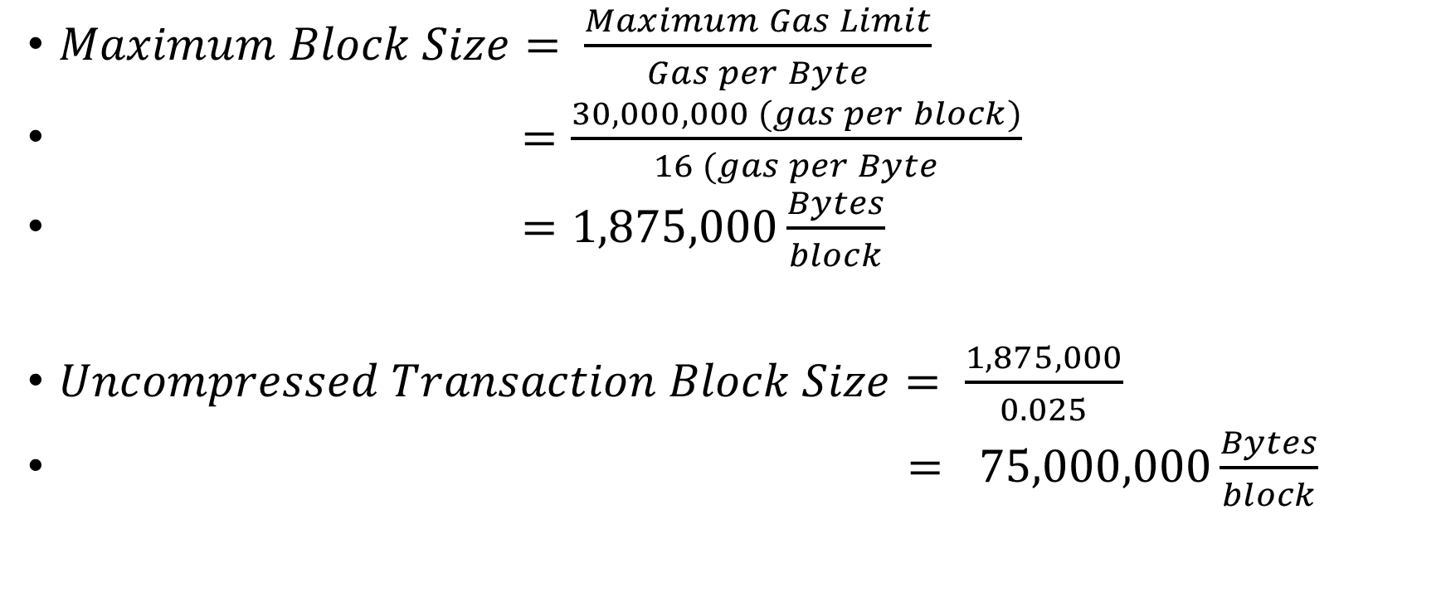
Theoretical Maximum Throughput
$Maximum Block Size= \frac{Maximum Gas Limit}{Gas per Byte}$
$=\frac{30,000,000 (gas per block)}{16 (gas per Byte}$
$=1,875,000\frac{Bytes}{block}$
$Uncompressed Transaction Block Size= \frac{1,875,000}{0.025}$
$= 75,000,000\frac{Bytes}{block}$

Slide 50
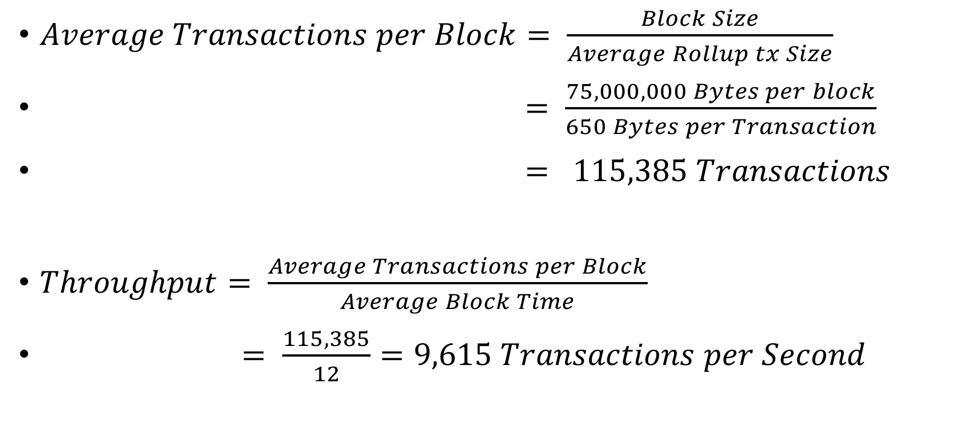
Theoretical Maximum Throughput
$Average Transactions per Block= \frac{Block Size}{Average Rollup tx Size}$
$= \frac{75,000,000 Bytes per block}{650 Bytes per Transaction}$
$= 115,385 Transactions$
$Throughput= \frac{Average Transactions per Block}{Average Block Time}$
$= \frac{115,385}{12}=9,615 Transactions per Second$

Slide 51
System Performance Evaluation
System | Max Theoretical Throughput (tps) | Practical Throughput (tps) | L2 Approach | Finality
Polygon | 65,000 | 6,900 | Side chain/Plasma | 3h(PoS),7days(Plasma)
Optimism | 200 | 110 | Optimistic Rollup | 7 days
Arbitrum | 4,500 | 102 | Optimistic Rollup | 7 days
ZKSync | 3,000 | 165 | Zero-Knowledge Rollup | 1 hour
This Work | 9,000 | 1¹ | Optimistic Rollup | 7 days

Slide 52
Characteristic Evaluation
Properties | Arbitrum | Optimism | Fuel V1 | This Work
Purpose | Universal | Universal | Payments | Payments
Model | Account | Account | UTXO | Account
Data Availability | On-chain | On-chain | On-chain | On-chain
State Validation | Fraud Proofs(MR)² | In Development | Fraud Proofs(SR)³ | Fraud Proofs
Upgreadibility | SC and DAO⁴ | Upgrade Keys | Immutable | Upgrade Keys
Centralized Sequence | Yes | Yes | Yes | Yes
Censorship Resistance | Self sequence | Self sequence | Self sequence | No mechanism
Security Audits | Yes | Yes | Yes | No
Rollup Stage | Stage 1 | Stage 0 | Stage 2 | Stage 0

Slide 53


Rollup Maturity Assessment
Stage 0 Requirements
Does the project call itself a Rollup?
Are L2 state roots posted on L1?
Does the project provide Data Availability (DA) on L1?
Is software capable of reconstructing the rollup’s state open source?
Stage 1 Requirements
Does the project use a proper proof system?
Are there at least 5 external actors that can submit a fraud proof?
Can the users exit without the operator’s coordination?
Do users have at least 7 days to exit in case of unwanted upgrades (Security Council and governance excluded)?
Is the Security Council properly set up?

Slide 54
Rollup Maturity Assessment
Stage 2 Requirements
Is the fraud proof system permissionless?
Do users have at least 30 days to exit in case of unwanted upgrades?
Is the Security Council restricted to act only due to errors detected on chain?

Slide 55
Usability
Light Protocol
All components of an Optimistic Rollup
Working Fraud Mechanism
Research and Development
Decentralized Sequencing
Aggressive bandwidth utilization
Scenarios in Rollups
Not recommended for production purposes

Slide 56
Limitations
Throughput Constraints
Sequencer responsibilities (User interface, Sequencing, Execution)
Centralized Seqeuencing
Limited Transparency in Transaction Data
Security Considerations
Lack of an Escape Hatch
Lack of Extensive Testing
Censorship Vulnerabilities

Slide 57
Limitations
Time-Constrained Withdrawal Process
Fraud proof Limitation
On-chain execution of complete batch

Slide 58
Future Work
Sequence and Execution Separation
A Fast low-level Implementation of Protocol
A Mechanism for Censorship Resistance
Trust-Minimized and Time-insensitive Withdrawal Process
Trust Removal from Sequenced Transaction Data
An Escape Hatch

Slide 59
Conclusion
Design and Implement a prototype for an Optimistic Rollup
Investigate the state-of-the-art
Present a comprehensive analysis of Rollup Economics
A thorough performance and characteristic assessment
Rollups are still far from their promises

Slide 60
Thank you

